Slide 1

Chapter 5
Divide-and-Conquer
Copyright © 2007 Pearson Addison-Wesley. All rights reserved.

Slide 2
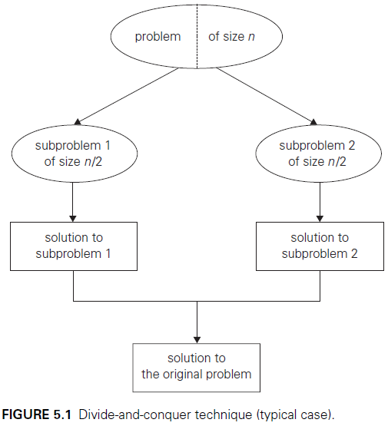
Introduction
Notes:
Divide-and-conquer algorithms work according to the following general plan:
A problem is divided into several subproblems of the same type, ideally of about equal size.
The subproblems are solved (typically recursively, though sometimes a different algorithm is employed, especially when subproblems become small enough).
If necessary, the solutions to the subproblems are combined to get a solution to the original problem.
The divide-and-conquer technique is diagrammed in Figure 5.1.

Slide 3
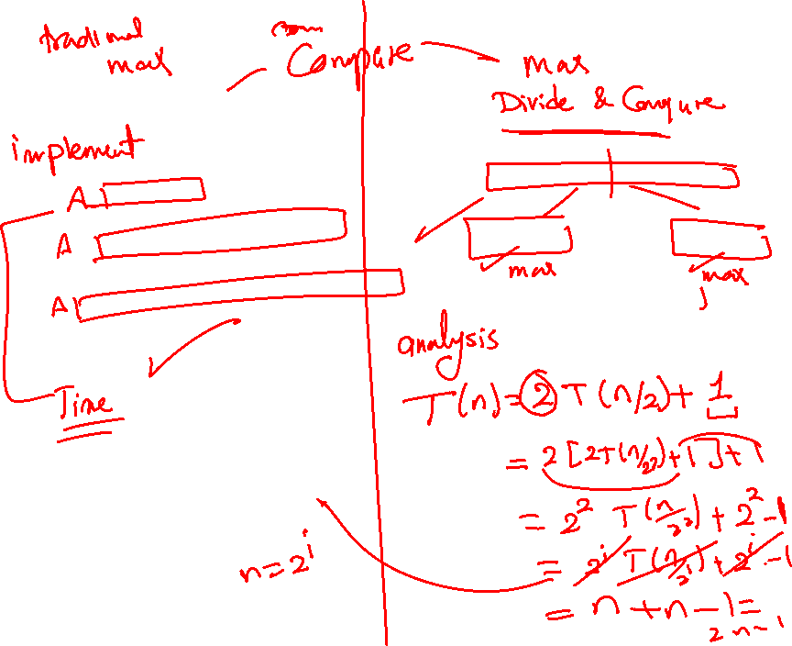

Slide 4
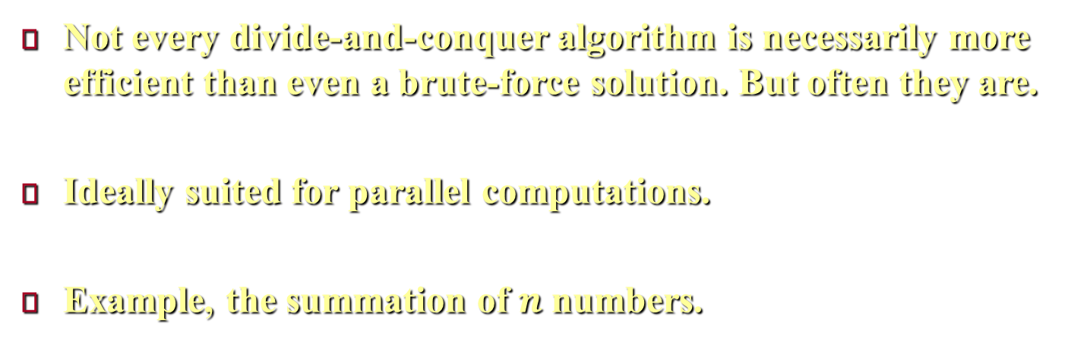
Introduction
Not every divide-and-conquer algorithm is necessarily more efficient than even a brute-force solution. But often they are.
Ideally suited for parallel computations.
Example, the summation of $n$ numbers.
Notes:
Not every divide-and-conquer algorithm is necessarily more efficient than even a brute-force solution. But often, the time spent on executing the divide-and-conquer plan turns out to be significantly smaller than solving a problem by a different method.
It is worth keeping in mind that the divide-and-conquer technique is ideally suited for parallel computations, in which each subproblem can be solved simultaneously by its own processor.
As an example, let us consider the problem of computing the sum of $n$ numbers $a_{0},a_{1}, …,a_{n−1}$. If $n > 1$, we can divide the problem into two instances of the same problem: to compute the sum of the first $⌊\text{n}\text{/}\text{2}⌋$ numbers and to compute the sum of the remaining $⎾n/2⏋$numbers. (Of course, if $n = 1$, we simply return $a_{0}$ as the answer). Once each of these two sums is computed by applying the same method recursively, we can add their values to get the sum in question: $a_{0}+a_{1}+…+a_{n−1}=\left(a_{0}+a_{1}+…+a_{\left\lfloor \text{n}\text{/}\text{2}\right\rfloor −1}\right)+\left(a_{\left\lfloor \text{n}\text{/}\text{2}\right\rfloor }+a_{1}+…+a_{n−1}\right)$.

Slide 5
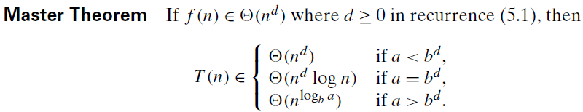
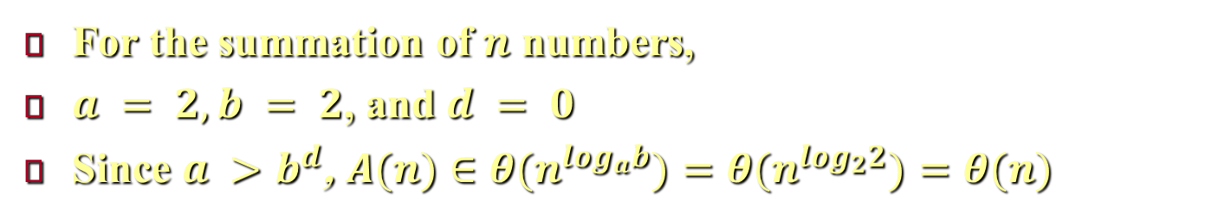

Introduction
For the summation of $n$ numbers,
$a = 2, b = 2$, and $d = 0$
$\text{S}\text{ince} a >b^{d}\text{, }A(n)∈θ(n^{\log_{a}b})=θ(n^{\log_{2}2})=θ(n)$
Notes:
In the divide-and-conquer a problem’s instance of size $n$ is divided into two instances of size $n/2$, or (more generally) into $b$ instances of size $n/b$, with $a$ of them needing to be solved. Assume that $n$ is a power of $b$ to simplify our analysis, we get the following recurrence for the running time $T(n)$: $T(n)=aT(n/b)+f (n)$. Where $f(n)$ is a function that accounts for the time spent on dividing an instance of size $n$ into instances of size $n/b$ and combining their solutions. (For the sum example, $a=b=2$ and $f(n)=1$).
Obviously, the order of growth of its solution $T(n)$ depends on the values of the constants $a$ and $b$ and the order of growth of the function $f(n)$. The efficiency analysis of many divide-and-conquer algorithms is greatly simplified by the above theorem.
For example, the recurrence for the number of additions A(n) made by the divide-and-conquer sum-computation algorithm on inputs of size $n=2^{k}$ is $A(n) = 2A(n/2) + 1.$
Thus, for this example, $a = 2, b = 2$, and $d = 0$; hence, since $a >b^{d}$, $A(n)∈θ(n^{\log_{a}b})=θ(n^{\log_{2}2})=θ(n)$.
It is also worth pointing out that if $a = 1$, recurrence (5.1) covers decrease-by-a-constant-factor algorithms discussed in the previous chapter. In fact, some people consider such algorithms as binary search degenerate cases of divide-and-conquer, where just one of two subproblems of half the size needs to be solved. It is better not to do this and consider decrease-by-a-constant-factor and divide-and-conquer as different design paradigms.

Slide 6
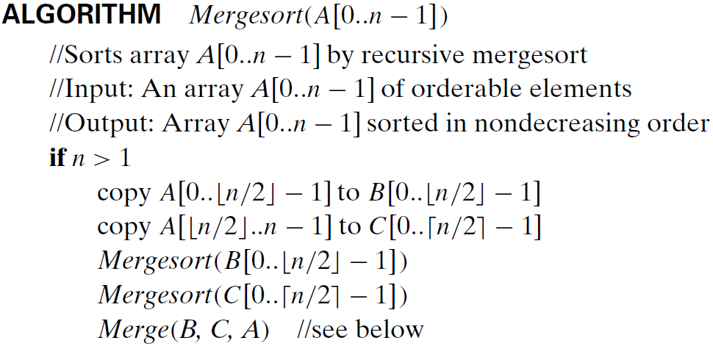
Mergesort
Notes:
Mergesort is a perfect example of a successful application of the divide-and-conquer technique. It sorts a given array $A[0..n − 1]$ by dividing it into two halves $A[0..\left\lfloor \text{n}\text{/}\text{2}\right\rfloor − 1]$ and $A[\left\lfloor \text{n}\text{/}\text{2}\right\rfloor ..n − 1]$, sorting each of them recursively, and then merging the two smaller sorted arrays into a single sorted one.

Slide 7
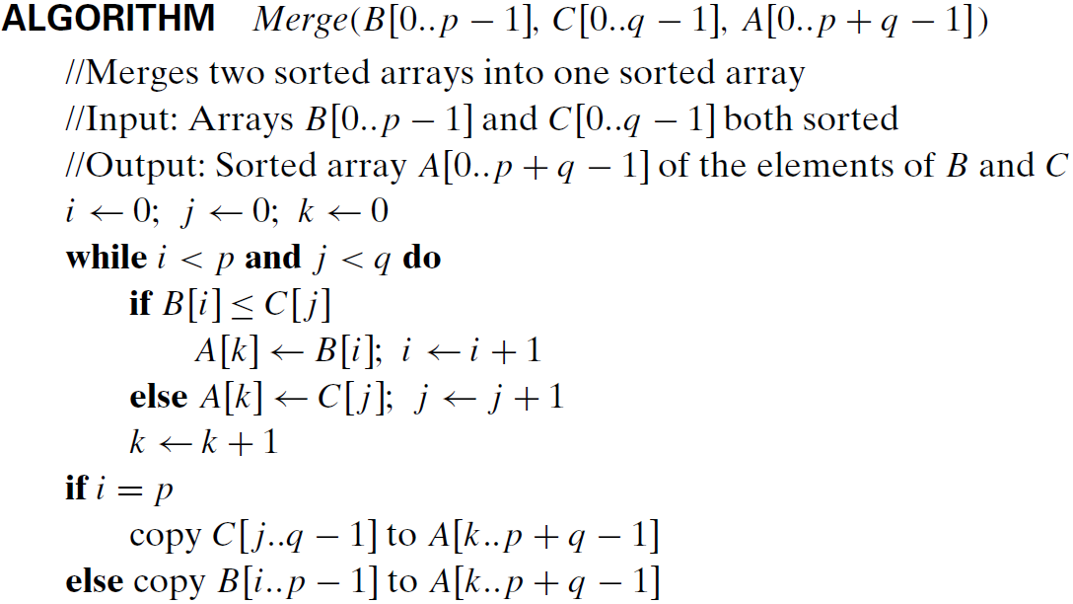
Mergesort
Notes:
The merging of two sorted arrays can be done as follows. Two pointers (array indices) are initialized to point to the first elements of the arrays being merged. The elements pointed to are compared, and the smaller of them is added to a new array being constructed; after that, the index of the smaller element is incremented to point to its immediate successor in the array it was copied from. This operation is repeated until one of the two given arrays is exhausted, and then the remaining elements of the other array are copied to the end of the new array.

Slide 8
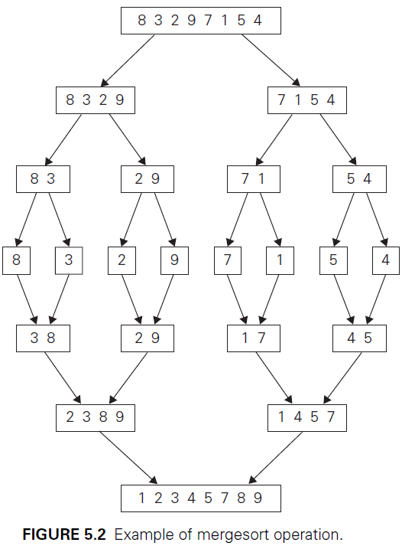

Mergesort
Notes:
The operation of the algorithm on the list 8, 3, 2, 9, 7, 1, 5, 4 is illustrated in Figure 5.2.

Slide 9
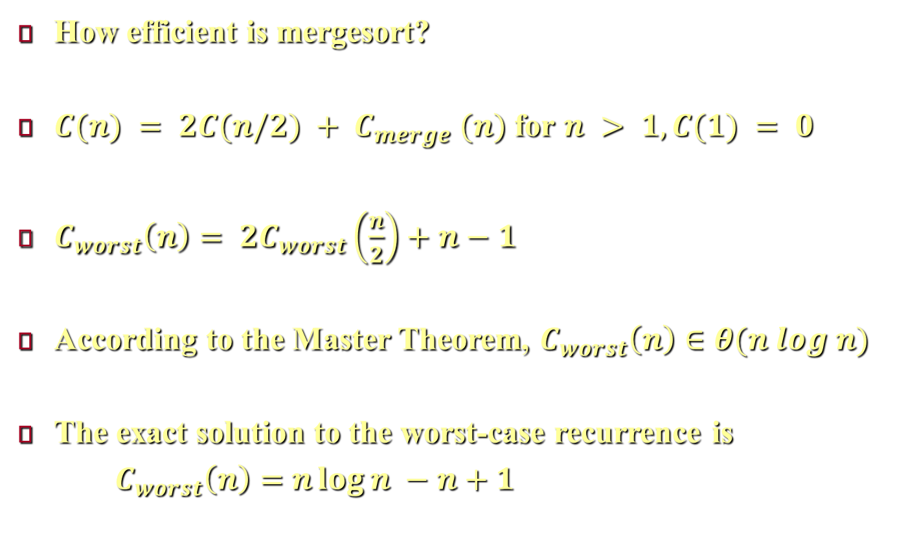
Mergesort
How efficient is mergesort?
$C(n) = 2C(n/2) + C_{merge} (n)$ for $n > 1, C(1) = 0$
$C_{worst}\left(n\right)= 2C_{worst}\left(\frac{n}{2}\right)+n−1$
According to the Master Theorem, $C_{worst}\left(n\right)∈θ(n log n)$
The exact solution to the worst-case recurrence is
$C_{worst}\left(n\right)=$ $n\log{n} −n+1$
Notes:
How efficient is mergesort? Assuming for simplicity that $n$ is a power of $2$, the recurrence relation for the number of key comparisons $C(n)$ is $C(n) = 2C(n/2) + C_{merge} (n)$ for $n > 1, C(1) = 0$.
Let us analyze $C_{merge}$, the number of key comparisons performed during the merging stage. At each step, exactly one comparison is made, after which the total number of elements in the two arrays still needing to be processed is reduced by 1. In the worst case, smaller elements may come from the alternating arrays (in this case, when one array is empty the other one contains just one element). Therefore, for the worst case, $C_{merge}=n−1$, and we have the recurrence $C_{worst}\left(n\right)= 2C_{worst}\left(\frac{n}{2}\right)+n−1$ for $n > 1,C_{worst}(1) = 0$. Therefor, according to the Master Theorem, $C_{worst}\left(n\right)∈θ(n log n)$. In fact, it is easy to find the exact solution to the worst-case recurrence for $n =2^{k}$: $C_{worst}\left(n\right)=n\log{n} −n+1$. (because $C_{worst}\left(n\right)= 2C_{worst}\left(\frac{n}{2}\right)+n−1$, then put $n =2^{k}$, $C_{worst}\left(2^{k}\right)= 2C_{worst}\left(2^{k−1}\right)+2^{k}−1=2\left[2C_{worst}\left(2^{k−2}\right)+2^{k−1}+1\right]+2^{k}−1=4C_{worst}\left(2^{k−2}\right)+\left(2\right)2^{k}−3=8C_{worst}\left(2^{k−3}\right)+\left(3\right)2^{k}−7=2^{i}C_{worst}\left(2^{k−i}\right)+\left(i\right)2^{k}−2^{i}+1$, when $k=i$, $C_{worst}\left(n\right)=2^{k}C_{worst}\left(1\right)+\left(k\right)2^{k}−2^{k}+1=n\log{n} −n+1$).

Slide 10
Mergesort
Advantage of mergesort:
The number of key comparisons very close to the theoretical minimum.
Stable
Disadvantage: Not in-place algorithm.
Variations of mergesort.
Bottom up by merging.
Multiway mergesort
Notes:
The number of key comparisons made by mergesort in the worst case comes very close to the theoretical minimum. However, the principal shortcoming of mergesort is the linear amount of extra storage the algorithm requires. Another advantage is stability (because if we have two elements of the same value in positions i and j, i < j, in a subarray before its two (sorted) halves are merged. If these two elements are in the same half of the subarray, their relative ordering will stay the same after the merging because the elements of the same half are processed by the merging operation in the FIFO fashion. In the case that A[i] is in the first half while A[j] is in the second half. A[j] is placed into the new array either after the first half becomes empty (and, hence, A[i] has been already copied into the new array) or after being compared with some key k > A[j] of the first half. In the latter case, since the first half is sorted before the merging begins, A[i] = A[j] < k cannot be among the unprocessed elements of the first half. Hence, by the time of this comparison, A[i] has been already copied into the new array and therefore will precede A[j] after the merging operation is completed. )
There are two main ideas leading to several variations of mergesort. First, the algorithm can be implemented bottom up by merging pairs of the array’s elements, then merging the sorted pairs, and so on. (If n is not a power of 2, only slight bookkeeping complications arise). This avoids the time and space overhead of using a stack to handle recursive calls. Second, we can divide a list to be sorted in more than two parts, sort each recursively, and then merge them together. This scheme, which is particularly useful for sorting files residing on secondary memory devices, is called multiway mergesort.

Slide 11
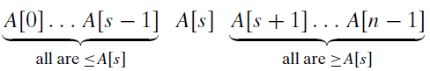
Quicksort
A[s] will be in its final position in the sorted array.
The two subarrays are sorted by the same method.
Note the difference with mergesort.
Notes:
Unlike mergesort, which divides its input elements according to their position in the array, quicksort divides them according to their value. We already encountered this idea of an array partition in Section 4.5, where we discussed the selection problem. A partition is an arrangement of the array’s elements so that all the elements to the left of some element A[s] are less than or equal to A[s], and all the elements to the right of A[s] are greater than or equal to it, as shown above.
Obviously, after a partition is achieved, A[s] will be in its final position in the sorted array, and we can continue sorting the two subarrays to the left and to the right of A[s] by the same method. Note the difference with mergesort: there, the division of the problem into two subproblems is immediate and the entire work happens in combining their solutions; here, the entire work happens in the division stage, with no work required to combine the solutions to the subproblems.

Slide 12
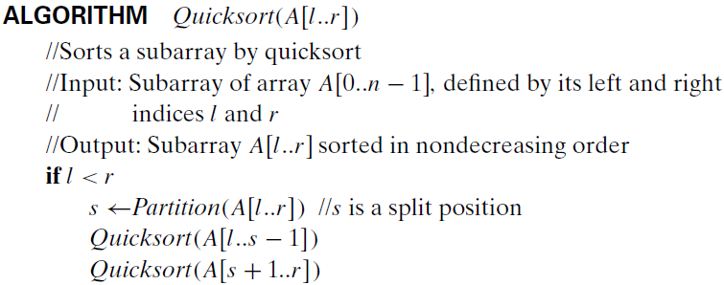
Quicksort
Here, we use Hoare partition.
Notes:
Above, is the pseudocode of quicksort.
We can certainly use the Lomuto partition discussed in Section 4.5. Alternatively, we can partition $A[0..n − 1]$ by the more sophisticated method suggested by Hoare, the British computer scientist who invented quicksort.

Slide 13
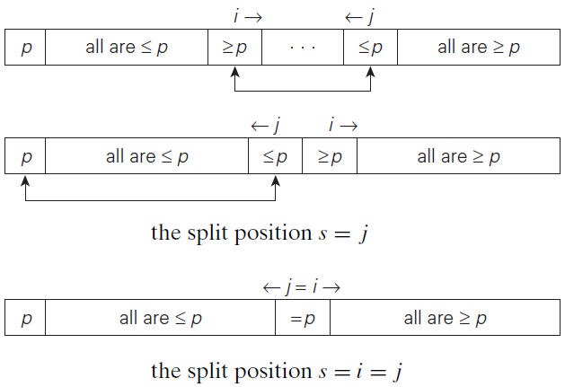
Quicksort
The last two cases can be combined.
Notes:
We start by selecting a pivot—an element with respect to whose value we are going to divide the subarray. For now, we use the simplest strategy of selecting the subarray’s first element: p = A[l].
Unlike the Lomuto algorithm, we scan the subarray from both ends, comparing the subarray’s elements to the pivot. The left-to-right scan, denoted below by index pointer i, starts with the second element. Since we want elements smaller than the pivot to be in the left part of the subarray, this scan skips over elements that are smaller than the pivot and stops upon encountering the first element greater than or equal to the pivot. The right-to-left scan, denoted below by index pointer j, starts with the last element of the subarray. Since we want elements larger than the pivot to be in the right part of the subarray, this scan skips over elements that are larger than the pivot and stops on encountering the first element smaller than or equal to the pivot.
After both scans stop, three situations may arise, depending on whether or not the scanning indices have crossed. If scanning indices i and j have not crossed, i.e., i < j, we simply exchange A[i] and A[j ] and resume the scans by incrementing i and decrementing j, respectively. If the scanning indices have crossed over, i.e., i > j, we will have partitioned the subarray after exchanging the pivot with A[j]. If the scanning indices stop while pointing to the same element, i.e., i = j, the value they are pointing to must be equal to p. Thus, we have the subarray partitioned, with the split position s = i = j.
We can combine the last case with the case of crossed-over indices (i > j ) by exchanging the pivot with A[j] whenever i ≥ j .

Slide 14
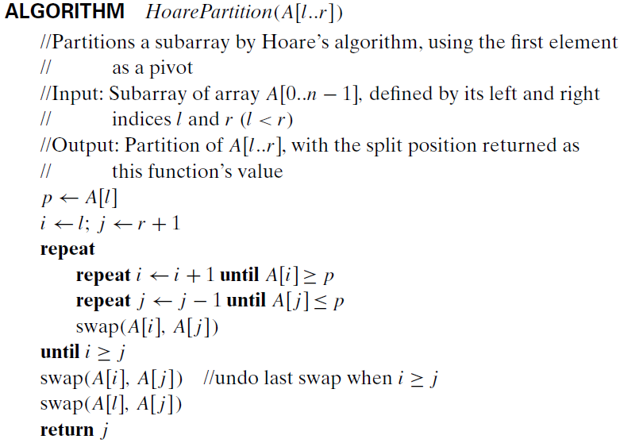
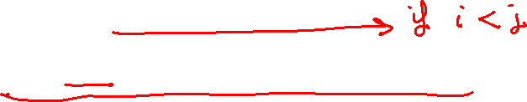
Quicksort
Notes:
Above, is pseudocode implementing this partitioning procedure.
Note that index i can go out of the subarray’s bounds in this pseudocode. Rather than checking for this possibility every time index i is incremented, we can append to array A[0..n − 1] a “sentinel” that would prevent index i from advancing beyond position n.

Slide 15
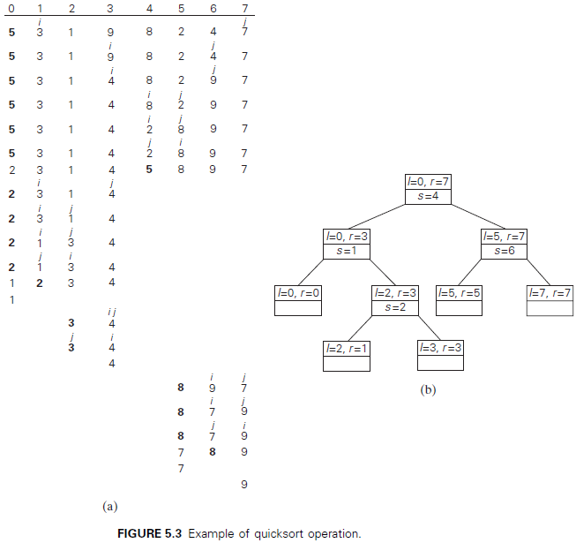
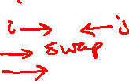
Quicksort
Notes:
An example of sorting an array by quicksort is given in Figure 5.3.

Slide 16
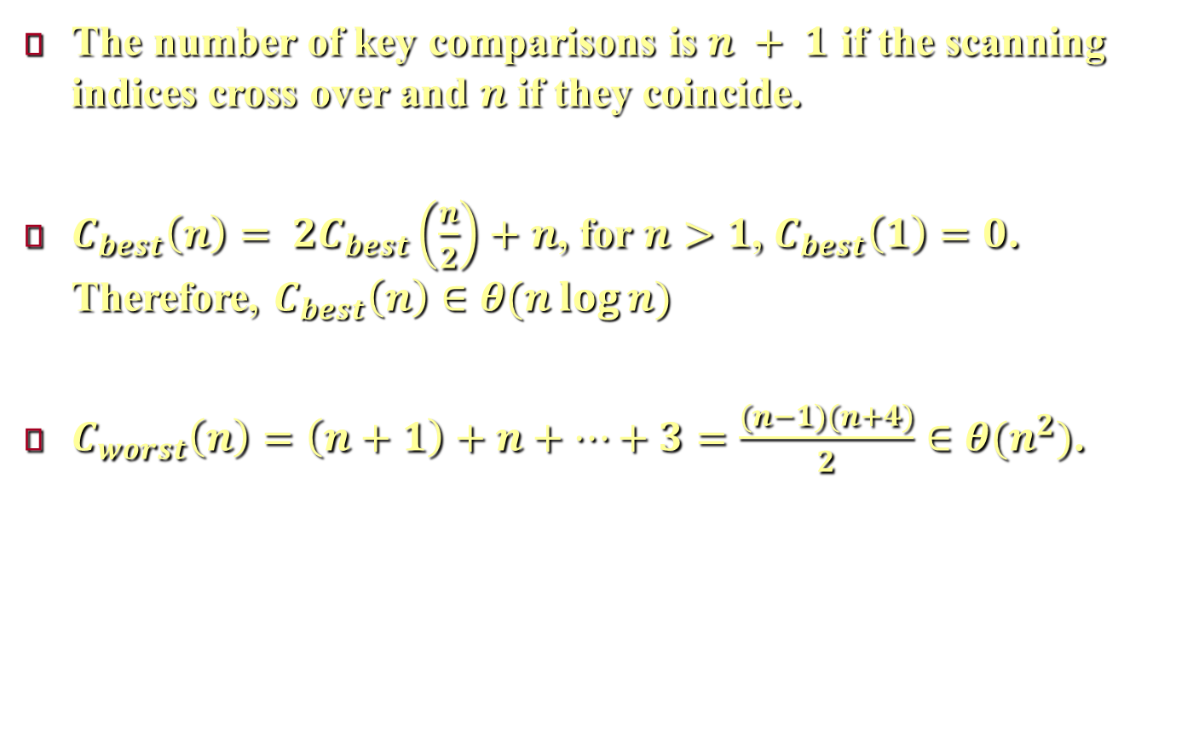
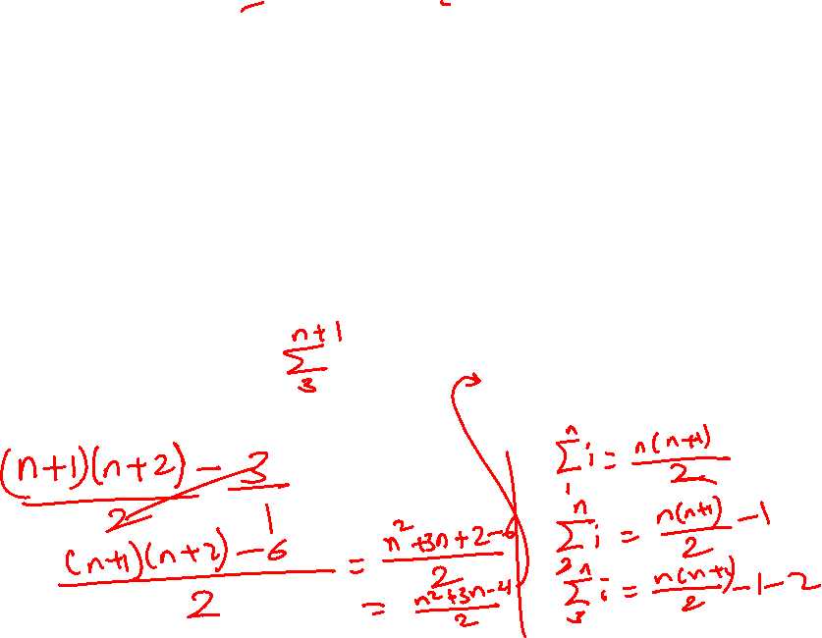
Quicksort
The number of key comparisons is $n + 1$ if the scanning indices cross over and $n$ if they coincide.
$C_{best}\left(n\right)= 2C_{best}\left(\frac{n}{2}\right)+n$, for $n>1$, $C_{best}\left(1\right)=0$. Therefore, $C_{best}\left(n\right)∈θ(n\log{n})$
$C_{worst}\left(n\right)=\left(n+1\right)+n+…+3=\frac{(n−1)(n+4)}{2}∈θ(n^{2})$.
Notes:
Note that, the number of key comparisons made before a partition is achieved is n + 1 if the scanning indices cross over and n if they coincide (because if the split happens at index s then, in the case that the left and right pointers coincide the number of comparisons are s [by the left pointer] and n-s [by the right pointer] which gives total of n comparisons. In the case that the two pointers cross over, the number of comparisons are s [by the left pointer] and n-s+1 [by the right pointer] which gives total of n+1 comparisons. You can test these two cases over the two arrays [5,3,5,8,11,9] and [5,3,6,9,8,7]).
In the best case, all the splits happen in the middle of corresponding subarrays, and then the number of key comparisons in the best case satisfies the recurrence $C_{best}\left(n\right)= 2C_{best}\left(\frac{n}{2}\right)+n$, for $n>1$, $C_{best}\left(1\right)=0$. Therefore, according to Master Theorem, $C_{best}\left(n\right)∈θ(n\log{n})$.
In the worst case, all the splits will be skewed to the extreme: one of the two subarrays will be empty, and the size of the other will be just 1 less than the size of the subarray being partitioned. This situation will happen when the input array is already sorted! Indeed, if A[0..n − 1] is sorted and we use A[0] as the pivot, the left-to-right scan will stop on A[1] while the right-to-left scan will go all the way to reach A[0], indicating the split at position 0 as shown above. So, after making n + 1 comparisons to get to this partition and exchanging the pivot A[0] with itself, the algorithm will be left with the strictly increasing array A[1..n − 1] to sort. This sorting of strictly increasing arrays of diminishing sizes will continue until the last one A[n − 2..n − 1] has been processed. The total number of key comparisons made will be equal to $C_{worst}\left(n\right)=\left(n+1\right)+n+…+3=\frac{(n−1)(n+4)}{2}∈θ(n^{2})$.

Slide 17
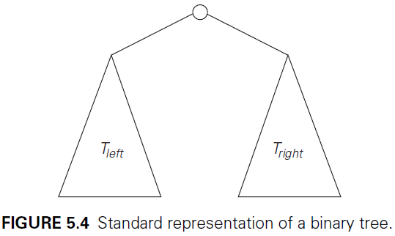

Binary Tree Traversals
Many problems about binary trees can be solved by applying the divide-and-conquer technique.
Example, computing the height of a binary tree.
Notes:
Since the definition itself divides a binary tree into two smaller structures of the same type, the left subtree and the right subtree, many problems about binary trees can be solved by applying the divide-and-conquer technique.
As an example, let us consider a recursive algorithm for computing the height of a binary tree.

Slide 18
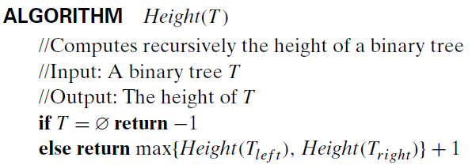
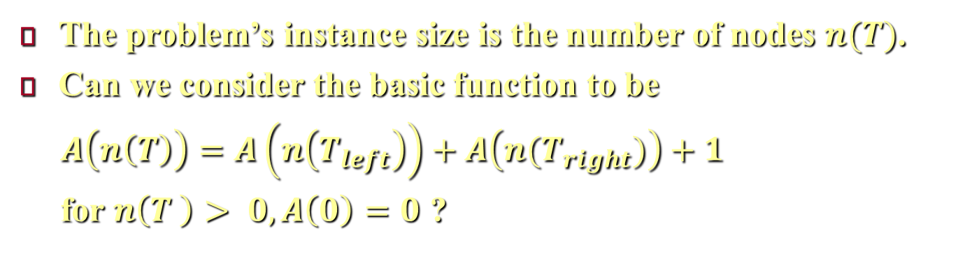

Binary Tree Traversals
The problem’s instance size is the number of nodes $n(T)$.
Can we consider the basic function to be
$A\left(n\left(T\right)\right)=A\left(n\left(T_{left}\right)\right)+A\left(n(T_{right})\right)+1$
for $n\left(T \right)> 0,A\left(0\right)=0$ ?
Notes:
The height of a binary tree can be computed as the maximum of the heights of the root’s left and right subtrees plus 1. (We have to add 1 to account for the extra level of the root.) Also note that it is convenient to define the height of the empty tree as −1. Thus, we have the above recursive algorithm.
We measure the problem’s instance size by the number of nodes n(T ) in a given binary tree T.
One can say that the number of comparisons made to compute the maximum of two numbers and the number of additions $A(n(T ))$ made by the algorithm are the same, then we have the recurrence relation: $A\left(n\left(T \right)\right)= A\left(n\left(T_{left}\right)\right)+ A\left(T_{right}\right)+1$ for $n\left(T \right)> 0,A\left(0\right)=0$.

Slide 19
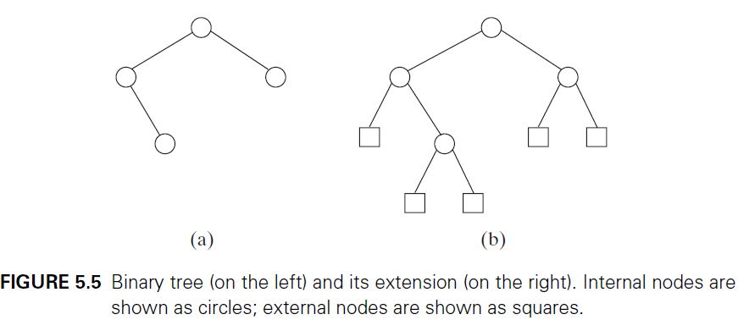
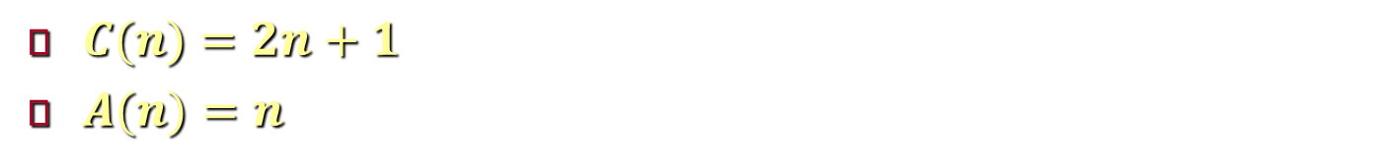
Binary Tree Traversals
Actually, the basic function is the comparison 𝑇 = ∅
$C(n)=2n+1$
$A(n)=n$
Notes:
The answer is no, because the most frequently executed operation of this algorithm is not the addition or the comparisons made to compute the maximum but the comparison $T = ∅$.
To explain this point it is convenient to draw the tree’s extension by replacing the empty subtrees by extra special nodes called external nodes. The external nodes are shown by little squares and the original (internal) are shown in by little circles in figure 5.5. According to this definition, the extension of the empty binary tree is a single external node.
Therefore, to get the algorithm’s efficiency, we need to know how many external nodes ($x$) exist in an extended binary tree with $n$ internal nodes.
Since every node, except the root, is one of the two children of an internal node, therefore the total number of internal and external nodes = 2n excluding the root and 2n+1 including the roots, i.e. $x+n=2n+1$, then $x=n+1$.
Returning to algorithm Height, we need to check all the nodes (internal or external), therefore the number of comparisons to check whether the tree is empty is $C(n) = n + x = 2n + 1$. Since addition happens only when there exist internal nodes then $A\left(n\right)=n$.

Slide 20
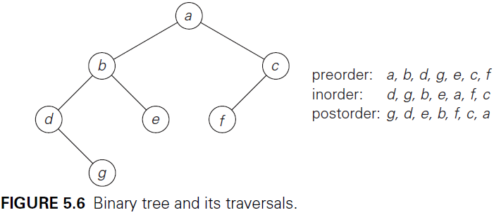
Binary Tree Traversals
Binary tree traversals.
Preorder (root - left - right)
Inorder (left - root - right)
Postorder (left - right - root)
Notes:
The most important divide-and-conquer algorithms for binary trees are the three classic traversals: preorder, inorder, and postorder. All three traversals visit nodes of a binary tree recursively. They differ only by the timing of the root’s visit.
In the preorder traversal, the root is visited before the left and right subtrees are visited (in that order).
In the inorder traversal, the root is visited after visiting its left subtree but before visiting the right subtree.
In the postorder traversal, the root is visited after visiting the left and right subtrees (in that order).
These traversals are illustrated in Figure 5.6.

Slide 21
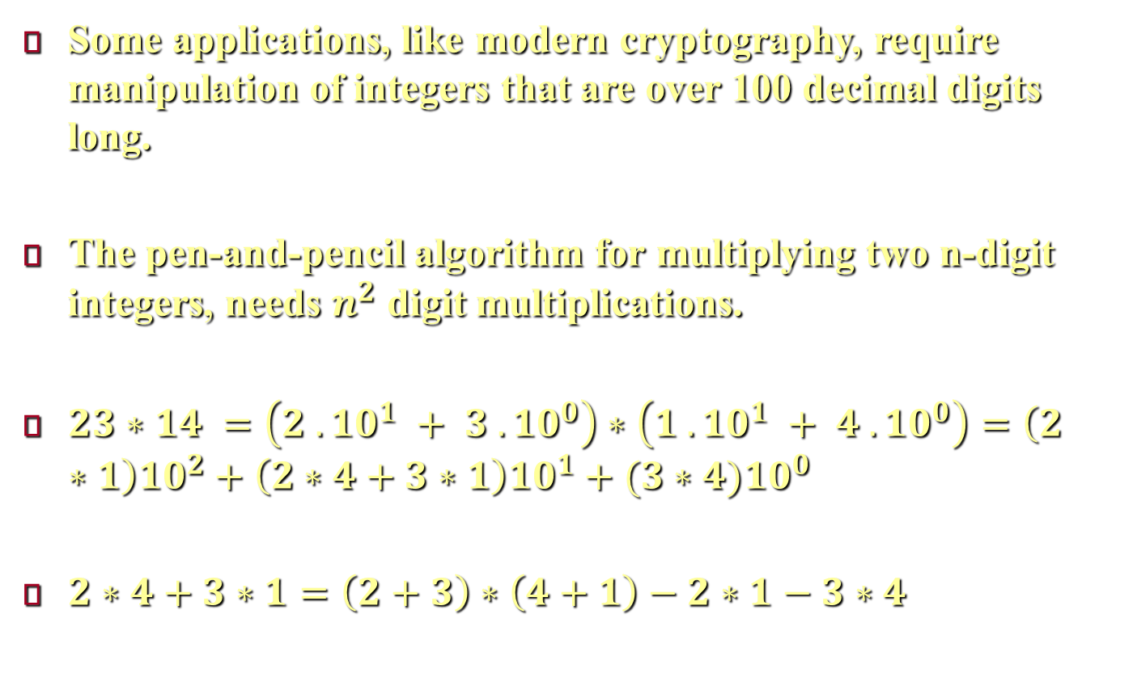

Multiplication of Large Integers
Some applications, like modern cryptography, require manipulation of integers that are over 100 decimal digits long.
The pen-and-pencil algorithm for multiplying two n-digit integers, needs $n^{2}$ digit multiplications.
$23∗14 =\left(2 . {10}^{1} + 3 . {10}^{0}\right)∗\left(1 . {10}^{1} + 4 . {10}^{0}\right)=\left(2∗1\right){10}^{2}+\left(2∗4+3∗1\right){10}^{1}+(3∗4){10}^{0}$
$2∗4+3∗1=\left(2+3\right)∗\left(4+1\right)−2∗1−3∗4$
Notes:
Some applications, notably modern cryptography, require manipulation of integers that are over 100 decimal digits long. Since such integers are too long to fit in a single word of a modern computer, they require special treatment.
If we use the conventional pen-and-pencil algorithm for multiplying two n-digit integers, each of the n digits of the first number is multiplied by each of the n digits of the second number for the total of $n^{2}$ digit multiplications (If one of the numbers has fewer digits than the other, we can pad the shorter number with leading zeros to equalize their lengths).
Divide-and-conquer can provide more efficient algorithm. To demonstrate the basic idea of this algorithm, let us start with a case of two-digit integers, say, 23 and 14. These numbers can be represented as 23 = 2 . ${10}^{1}$ + 3 . ${10}^{0}$ and 14 = 1 . ${10}^{1}$ + 4 . ${10}^{0}$. Therefore, $23∗14 =\left(2 . {10}^{1} + 3 . {10}^{0}\right)∗\left(1 . {10}^{1} + 4 . {10}^{0}\right)=\left(2∗1\right){10}^{2}+\left(2∗4+3∗1\right){10}^{1}+(3∗4){10}^{0}$. Note that, the number of multiplication is 2*2=4 (as the pen-and-pencil algorithm). There is another way to compute the middle term with just one digit multiplication by taking advantage of the products 2 ∗ 1 and 3 ∗ 4 that need to be computed anyway as follows. $2∗4+3∗1=\left(2+3\right)∗\left(4+1\right)−2∗1−3∗4$.

Slide 22
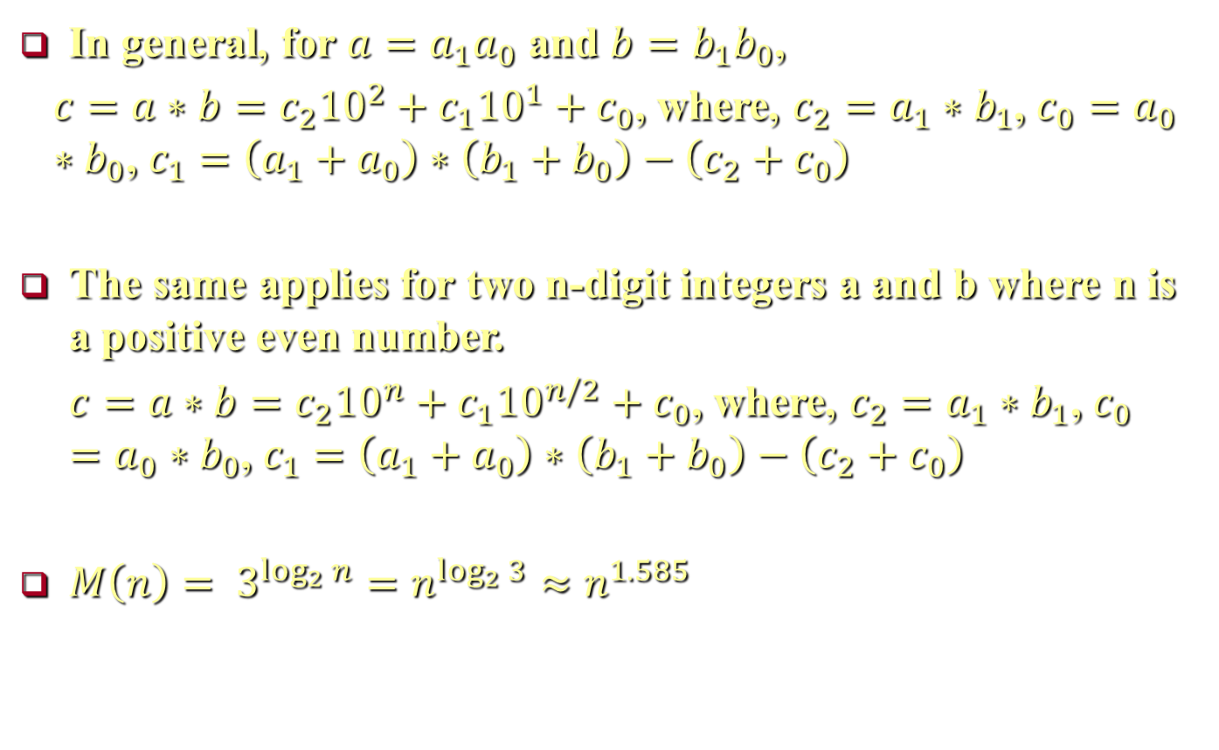
Multiplication of Large Integers
In general, for $a=a_{1}a_{0}$ and $b=b_{1}b_{0}$,
$c=a∗b=c_{2}{10}^{2}+c_{1}{10}^{1}+c_{0}$, where, $c_{2}=a_{1}∗b_{1}$, $c_{0}=a_{0}∗b_{0}$, $c_{1}=\left(a_{1}+a_{0}\right)∗\left(b_{1}+b_{0}\right)−\left(c_{2}+c_{0}\right)$
The same applies for two n-digit integers a and b where n is a positive even number.
$c=a∗b=c_{2}{10}^{n}+c_{1}{10}^{n/2}+c_{0}$, where, $c_{2}=a_{1}∗b_{1}$, $c_{0}=a_{0}∗b_{0}$, $c_{1}=\left(a_{1}+a_{0}\right)∗\left(b_{1}+b_{0}\right)−\left(c_{2}+c_{0}\right)$
$M\left(n\right)= 3^{\log_{2} n}=n^{\log_{2} 3}≈n^{1.585}$
Notes:
In general, for any pair of two-digit numbers $a=a_{1}a_{0}$ and $b=b_{1}b_{0}$, their product $c$ can be computed by the formula $c=a∗b=c_{2}{10}^{2}+c_{1}{10}^{1}+c_{0}$, where, $c_{2}=a_{1}∗b_{1}$, $c_{0}=a_{0}∗b_{0}$, $c_{1}=\left(a_{1}+a_{0}\right)∗\left(b_{1}+b_{0}\right)−\left(c_{2}+c_{0}\right)$.
This can be applied to multiplying two n-digit integers a and b where n is a positive even number. Let us divide both numbers in the middle to take advantage of the divide-and-conquer technique. We denote the first half of the a’s digits by $a_{1}$ and the second half by $a_{0}$; for b, the notations are $b_{1}$ and $b_{0}$, respectively. In these notations, $a=a_{1}a_{0}$ implies that $a=a_{1}{10}^{n/2}+a_{0}$ and $b=b_{1}b_{0}$ implies that $b=b_{1}{10}^{n/2}+b_{0}$. Therefore, taking advantage of the same trick we used for two-digit numbers, we get $c=a∗b=c_{2}{10}^{n}+c_{1}{10}^{n/2}+c_{0}$, where, $c_{2}=a_{1}∗b_{1}$, $c_{0}=a_{0}∗b_{0}$, $c_{1}=\left(a_{1}+a_{0}\right)∗\left(b_{1}+b_{0}\right)−\left(c_{2}+c_{0}\right)$.
If $n/2$ is even, we can apply the same method for computing the products $c_{2}$, $c_{0}$, and $c_{1}$. Thus, if n is a power of 2, we have a recursive algorithm for computing the product of two n-digit integers, the recursion is stopped when n becomes 1 or n is small enough to multiply the numbers of that size directly.
Since multiplication of n-digit numbers requires three multiplications of $n/2$-digit numbers, the recurrence for the number of multiplications $M(n)$ is $M(n) = 3M(n/2)$ for n > 1, $M(1)=1$.
for $n =2^{k}$ yields $M(2^{k}) = 3M(2^{k−1}) = 3[3M(2^{k−2})]=3^{2}M(2^{k−2}) = . . . =3^{i}M(2^{k−i}) = . . . =3^{k}M(2^{k−k})=3^{k}$. Since $k = \log_{2} n$, $M\left(n\right)= 3^{\log_{2} n}=n^{\log_{2} 3}≈n^{1.585}$ (Note that $a^{\log_{b} c}=c^{\log_{b} a}$).

Slide 23
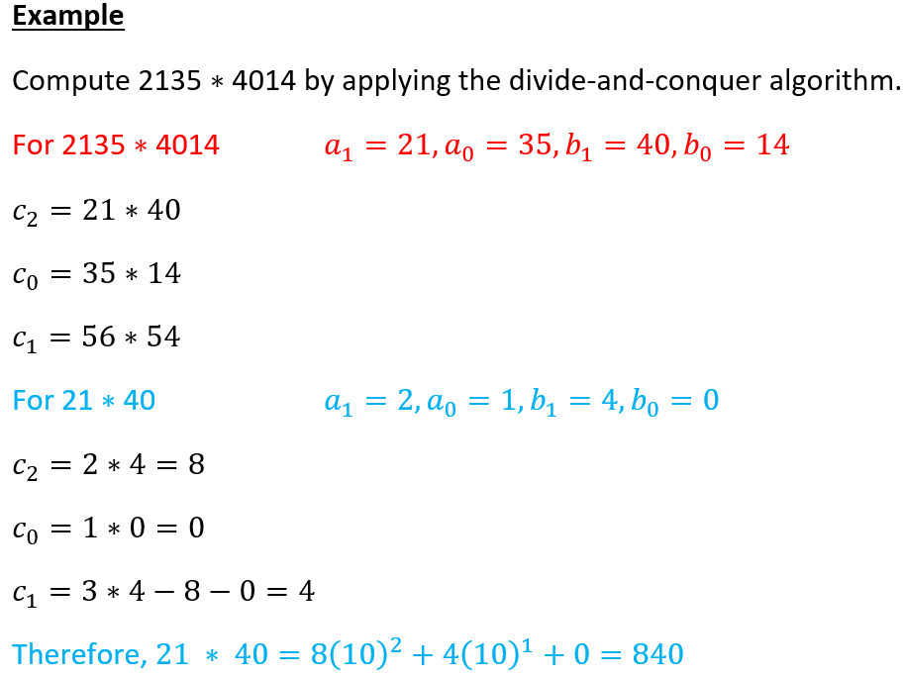
Multiplication of Large Integers

Slide 24
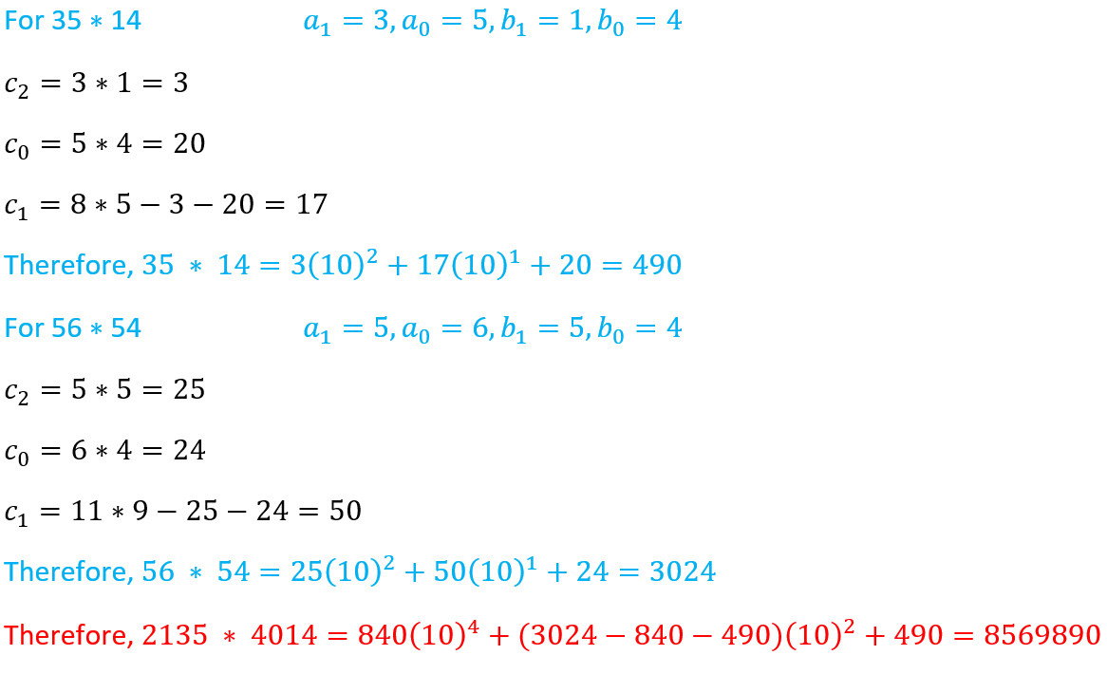
Multiplication of Large Integers

Slide 25
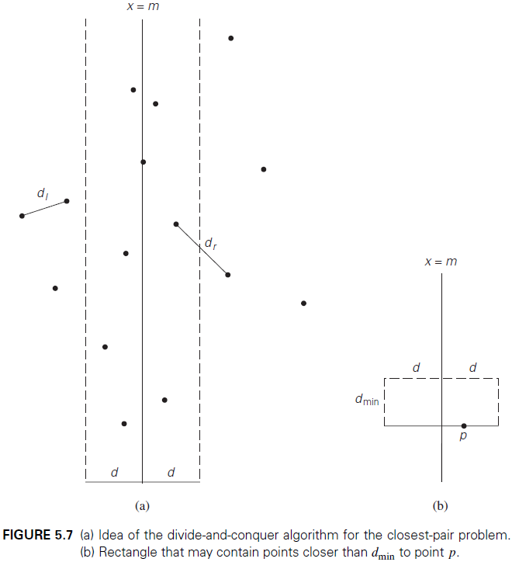
The Closest-Pair Problem
Notes:
For the sake of simplicity, we assume that the points are distinct, ordered in nondecreasing order of their x coordinate, and ordered in a separate list (list Q) in nondecreasing order of the y coordinate.
If $2 ≤ n ≤ 3$, the problem can be solved by the obvious brute-force algorithm. If $n > 3$, we can divide the points into two subsets $P_{l}$ and $P_{r}$ of $⎾n/2⏋$and $\left\lfloor \text{n}\text{/}\text{2}\right\rfloor$ points, respectively, by drawing a vertical line through the median m of their x coordinates so that $⎾n/2⏋$ points lie to the left of or on the line itself, and $\left\lfloor \text{n}\text{/}\text{2}\right\rfloor$ points lie to the right of or on the line. Then we can solve the closest-pair problem recursively for subsets $P_{l}$ and $P_{r}$. Let $d_{l}$ and $d_{r}$ be the smallest distances between pairs of points in $P_{l}$ and $P_{r}$ , respectively, and let $d = min⁡\{d_{l}\text{,} r_{r}\}$.
Note that $d$ is not necessarily the smallest distance between all the point pairs because points of a closer pair can lie on the opposite sides of the separating line. Therefore, as a step combining the solutions to the smaller subproblems, we need to examine such points. Obviously, we can limit our attention to the points inside the symmetric vertical strip of width $2d$ around the separating line, since the distance between any other pair of points is at least $d$ (Figure 5.7a).
Let S be the list of points inside the strip of width 2d around the separating line, obtained from Q and hence ordered in nondecreasing order of their y coordinate. We will scan this list, updating the information about $d_{min}$, the minimum distance seen so far, if we encounter a closer pair of points. Initially, $d_{min}=d$, and subsequently $d_{min}$ ≤ d. Let $p(x, y)$ be a point on this list. For a point $p^{′}(x^{′},y^{′})$ to have a chance to be closer to p than $d_{min}$, the point must follow p on list S and the difference between their y coordinates must be less than $d_{min}$ (why?). Geometrically, this means that p must belong to the rectangle shown in Figure 5.7b. The principal insight exploited by the algorithm is the observation that the rectangle can contain just a few such points, because the points in each half (left and right) of the rectangle must be at least distance d apart.

Slide 26
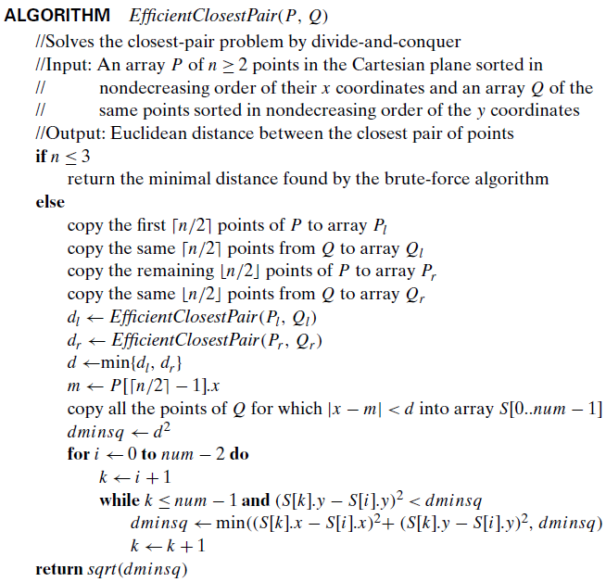
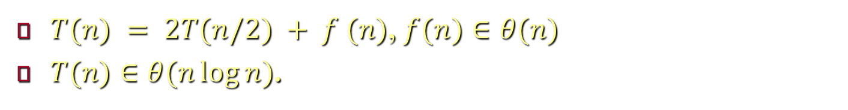
The Closest-Pair Problem
$T(n) = 2T(n/2) + f (n)$, $f(n)∈θ(n)$
$T(n)∈θ(n\log{n})$.
Notes:
Above, is pseudocode of the algorithm. We follow the advice given in Section 3.3 to avoid computing square roots inside the innermost loop of the algorithm.
The algorithm spends linear time both for dividing the problem into two problems half the size and combining the obtained solutions (because dividing and other operations can be implemented in single loops). Therefore, assuming as usual that n is a power of 2, we have the following recurrence for the running time of the algorithm: $T(n) = 2T(n/2) + f (n)$, where $f(n)∈θ(n)$. Applying the Master Theorem (with a = 2, b = 2, and d = 1), we get $T(n)∈θ(n\log{n})$. The necessity to presort input points does not change the overall efficiency class if sorting is done by a $O(n log⁡n)$ algorithm such as mergesort.

Slide 27
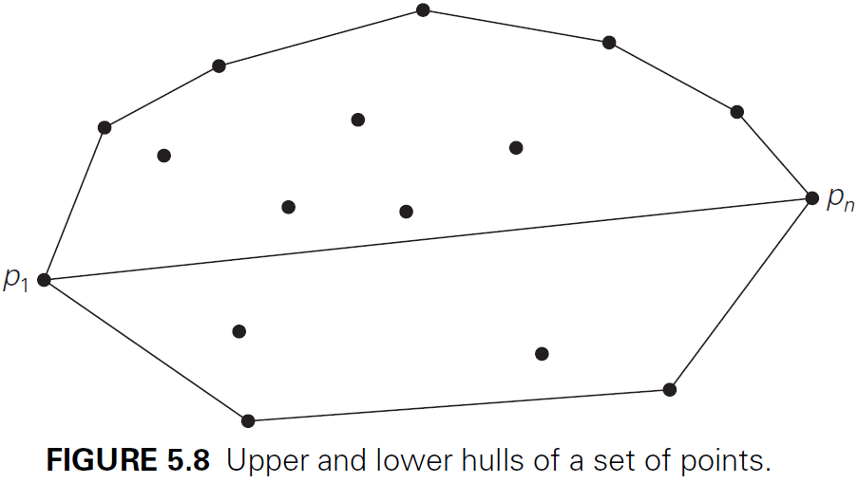
Convex-Hull Problem
Notes:
We consider here a divide-and-conquer algorithm called quickhull because of its resemblance to quicksort. Let S be a set of n>1 points $p_{1}$($x_{1}$,$y_{1}$), . . . , $p_{n}$($x_{n}$,$y_{n}$) in the Cartesian plane.
We assume that the points are sorted in nondecreasing order of their $x$ coordinates, with ties resolved by increasing order of the y coordinates of the points involved (when two points have the same x-coordinate they are sorted in nondecreasing order of their y coordinates). Therefore, $p_{1}$ is the leftmost point and $p_{n}$ is the rightmost point, i.e. $p_{1}$ and $p_{n}$ are two distinct extreme points of the set’s convex hull (Figure 5.8).
Let $\vec{p_{1}p_{n}}$ be the straight line directed from $p_{1}$ to $p_{n}$. This line separates the points of S into two sets: $S_{1}$ is the set of points to the left of this line, and $S_{2}$ is the set of points to the right of this line. (We say that point $q_{3}$ is to the left of the line $q_{1}q_{2}$ directed from point $q_{1}$ to point $q_{2}$ if $q_{1}q_{2}q_{3}$ forms a counterclockwise cycle. Later, we show an analytical way to check this condition, based on checking the sign of a determinant formed by the coordinates of the three points). The points of S on the line $\vec{p_{1}p_{n}}$, other than $p_{1}$ and $p_{n}$, cannot be extreme points of the convex hull and hence are excluded from further consideration.
The boundary of the convex hull of S is made up of two polygonal chains: an “upper” boundary and a “lower” boundary. The “upper” boundary, called the upper hull, is a sequence of line segments with vertices at $p_{1}$, some of the points in $S_{1}$ (if $S_{1}$ is not empty) and $p_{n}$. The “lower” boundary, called the lower hull, is a sequence of line segments with vertices at $p_{1}$, some of the points in $S_{2}$ (if $S_{2}$ is not empty) and $p_{n}$.

Slide 28
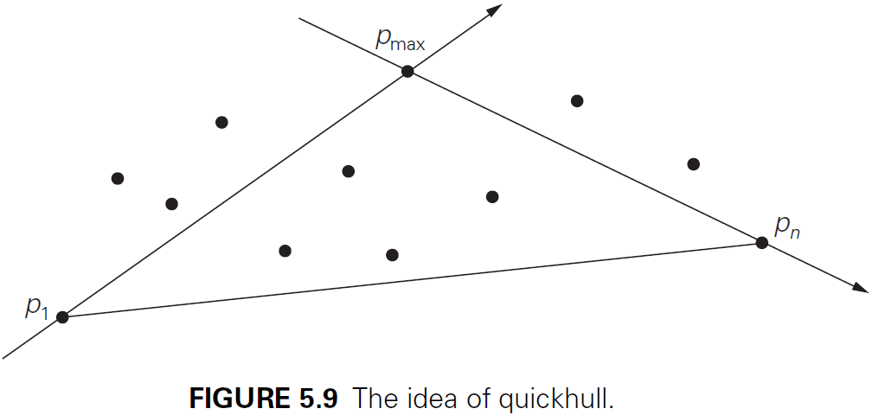
Convex-Hull Problem
Notes:
Let us discuss how quickhull proceeds to construct the upper hull; the lower hull can be constructed in the same manner. If $S_{1}$ is empty, the upper hull is simply the line segment with the endpoints at $p_{1}$ and $p_{n}$. If $S_{1}$ is not empty, the algorithm identifies point $p_{max}$ in $S_{1}$, which is the farthest from the line $\vec{p_{1}p_{n}}$ (Figure 5.9). Note that, in this case $p_{max}$ gives the maximum area of the triangle $p_{1}p_{n}p_{max}$. If there is a tie, the point that maximizes the angle $∠p_{max}p_{1}p_{n}$ can be selected. Then the algorithm identifies all the points of set $S_{1}$ that are to the left of the line $\vec{p_{1}p_{max}}$; these are the points that will make up the set $S_{1,1}$. The points of $S_{1}$ to the left of the line $\vec{p_{max}p_{n}}$ will make up the set $S_{1,2}$. Therefore, the following are applied:
The points inside $△p_{1}p_{max}p_{n}$ cannot be vertices of the upper hull (and hence can be eliminated from further consideration).
There are no points to the left of both lines $\vec{p_{1}p_{max}}$, and $\vec{p_{max}p_{1}}$.
Therefore, the algorithm can continue constructing the upper hulls of $p_{1}∪S_{1,1}∪p_{max}$ and $p_{max}∪S_{1,2}∪p_{1}$ recursively and then simply concatenate them to get the upper hull of the entire set $p_{1}∪S_{1}∪p_{n}$.

Slide 29
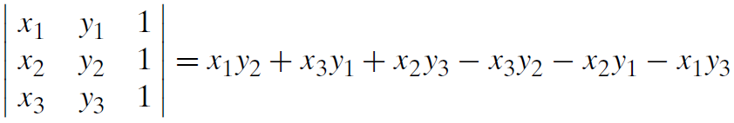
Convex-Hull Problem
Example
P_{max}
P_{y}
P_{x}
P₂
P₁
Notes:
Now we have to figure out how the algorithm’s geometric operations can be actually implemented. Fortunately, we can take advantage of the following very useful fact from analytical geometry: if $q_{1}(x_{1},y_{1}),q_{2}(x_{2},y_{2})$, and $q_{3}(x_{3},y_{3})$ are three arbitrary points in the Cartesian plane, then the area of the triangle $△q_{1}q_{2}q_{3}$ is equal to one-half of the magnitude of the determinant shown above, while the sign of this expression is positive if and only if the point $q_{3}(x_{3},y_{3})$ is to the left of the line $\vec{q_{1}q_{2}}$. Using this formula, we can check in constant time whether a point lies to the left of the line determined by two other points as well as find the distance from the point to the line.
The above figure shows an example of the quickhull in the upper hull.
First the red line divides the hull.
In the upper hull the maximum point $P_{max}$ is chosen.
The green line divides the upper hull into left and right.
There is one point $P_{x}$ in the left so it is chosen.
In the right hull all points are excluded as it belongs to $△p_{1}p_{max}p_{n}$ except $P_{y}$ which is chosen.
The same is applied in the lower hull.

Slide 30
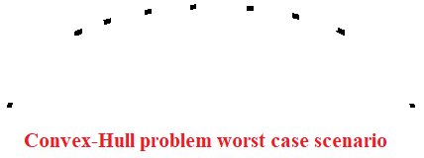
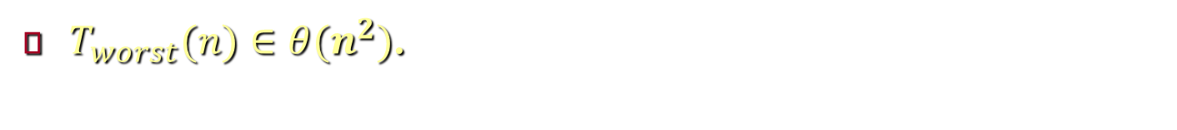
Convex-Hull Problem
$T_{worst}(n)∈θ(n^{2})$.
Notes:
Quickhull has the same $θ\left(n^{2}\right)$ worst-case efficiency as quicksort. This case can happen when $p_{1}$ and $p_{n}$ are the endpoints of the horizontal diameter of some circumference, and the other points are placed successively in the middle of this circumference’s upper arc, as shown above (because in this case no point will be excluded from the geometric operations).

